Slide 1
IMAGINE AI

Slide 2
Group Members Mahnoor Ijaz (21-NTU-CS-1329) Kainat Murtaza (21-NTU-CS-1323) Abubakar Nadeem (21-NTU-CS-1291)

Slide 3
Problem

Slide 4

Precision in Image Search
Traditional image search engines often struggle to provide precise results based on specific textual prompts. This limitation arises from the reliance on keyword matching and metadata, which may not capture the nuanced context or desired elements of an image. As a result, users may encounter frustration and inefficiency when attempting to find visuals that accurately reflect their needs or preferences.

Slide 5
Solution

Slide 6
AI-Powered Image Generation
Our solution leverages artificial intelligence (AI) algorithms to generate images based on specific textual prompts provided by users. By training machine learning models on vast datasets of images and associated text, we enable our system to understand and interpret complex semantic relationships, resulting in more accurate and relevant image generation. This approach circumvents the limitations of traditional keyword-based search methods, offering users a precise and tailored visual experience.

Slide 7
Fuzzy Logic

Slide 8
01
02
03
Text- Interpretation
Interpret user text descriptions as fuzzy sets to map descriptive words to image attributes.
Image Generation
Use fuzzy rules to align image characteristics with the nuances of the text description.
Filter Application
Apply and blend filters based on fuzzy sets to achieve desired artistic styles.

Slide 9
04
Version Generation
Create image variations by applying fuzzy logic to define subtle differences.
User Selection & Preferences
05
Fine-tune images using fuzzy logic based on user feedback.
Social media sharing
06
Enhance images using fuzzy adjustments tailored to platform-specific preferences before sharing.

Slide 10
Data Set

Slide 11
Data set Link
https://drive.google.com/drive/folders/18AES5sKUhCL60EfUOby7cYPWQsbfjxov?usp=sharing

Slide 12
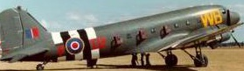
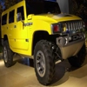
Use these Images/data to Train our AI Model
Planes
Car

Slide 13
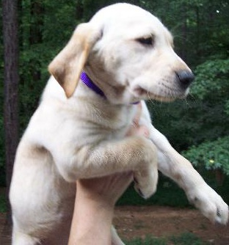
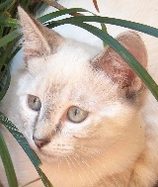
Use these Images/data to Train our AI Model
Cat
Dog

Slide 14
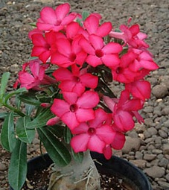
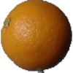
Use these Images/data to Train our AI Model
Flowers
Fruits

Slide 15
API
Implementation

Slide 16
Code
if (response.statusCode == 200) { // Check if the content type indicates binary data (image)
if (response.headers['content-type']?.contains('image/jpeg') == true || response.headers['content-type']?.contains('image/png') == true)
{ return response.bodyBytes; }
else { print( 'Unexpected response format: ${response.headers["content-type"]}');
print('Response Body: ${response.body}'); } }
else if (response.statusCode == 503) { // Handle the service unavailable error
final Map<String, dynamic> responseBody = json.decode(response.body); final double estimatedTime = responseBody['estimated_time'];
print( 'Model is loading. Estimated time: ${estimatedTime.toStringAsFixed(2)} seconds.');
print('Please retry after the estimated time.'); }

Slide 17
Code
else {
print('HTTP Error: ${response.statusCode}'); #
print('Response Body: ${response.body}'); } }
catch (e) { // Handle network and other unexpected errors
print('Network or unexpected error: $e'); } throw Exception('Failed to query model'); }}

Slide 18
Code Description

Slide 19
Http Request Handling
The code is likely part of a function or method that takes an HTTP response object (response) as input.
It checks the status code of the response using response.statusCode.
Response Handling based on Status Code:
If the status code is 200, it further checks the content type of the response to determine if it's an image (JPEG or PNG).
If it's an image, it returns the body of the response as bytes.
If it's not an image, it prints out the content type and body of the response, indicating that the format was unexpected.
Handling Specific HTTP Status Codes:
If the status code is 503 (Service Unavailable), it assumes there's a model loading and extracts the estimated time from the response body, printing it out for the user to see.
If the status code is anything else, it simply prints out the HTTP error code and the response body.

Slide 20
Error Handling:
The code is wrapped in a try-catch block to handle any network-related or unexpected errors that might occur during the HTTP request.
If an error occurs, it prints out the error message.
Throwing an Exception:
At the end of the function, there's a line that throws an exception with the message 'Failed to query model'. This suggests that if none of the conditions above are met (i.e., the response status code is neither 200 nor 503, or there's an error during the request), the function will throw this exception.

Slide 21
Framework

Slide 22
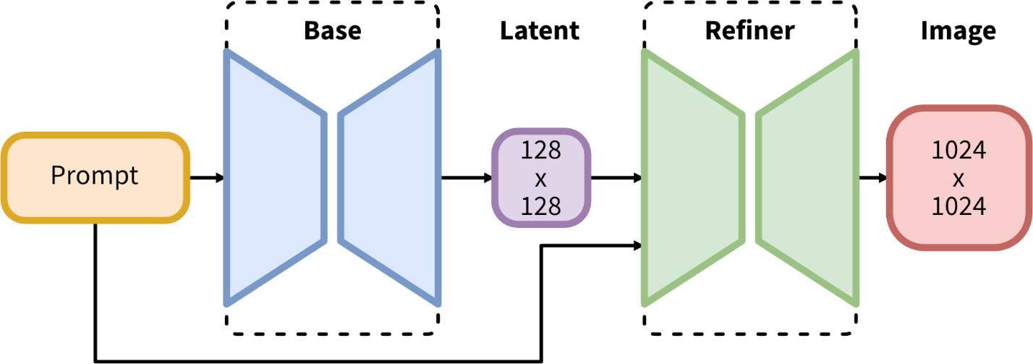

Slide 23
Latent Diffusion Model:
Latent Space: This refers to a compressed representation of data. Instead of working directly with high-dimensional
images, the model transforms the images into a lower-dimensional latent space using an auto encoder.
This makes the learning and generation processes more efficient.
Diffusion Process: This involves a forward and reverse process. In the forward process,
data is gradually turned into noise. In the reverse process, the model learns to denoise this noisy data back to its
original form.

Slide 24
Training Procedure:
Auto encoder: The auto encoder encodes images into latent space (a lower-dimensional space) and then decodes them
back to the original image space. This helps in efficiently learning the patterns and structures in the images.
Diffusion Process in Latent Space: Instead of applying the diffusion process directly to high-dimensional image data,
Stable Diffusion applies it to the latent representations created by the auto encoder. This reduces computational
complexity and focuses on the most important features of the data.

Slide 25
Steps of Diffusion:
Forward Process: The original image is incrementally corrupted by adding noise at each step, resulting in a fully noisy
image.
Reverse Process: The model is trained to remove this noise step-by-step, reconstructing the image from the noise.
This denoising is guided by the input text prompt, ensuring that the generated image matches the desired description.

Slide 26
Results

Slide 27
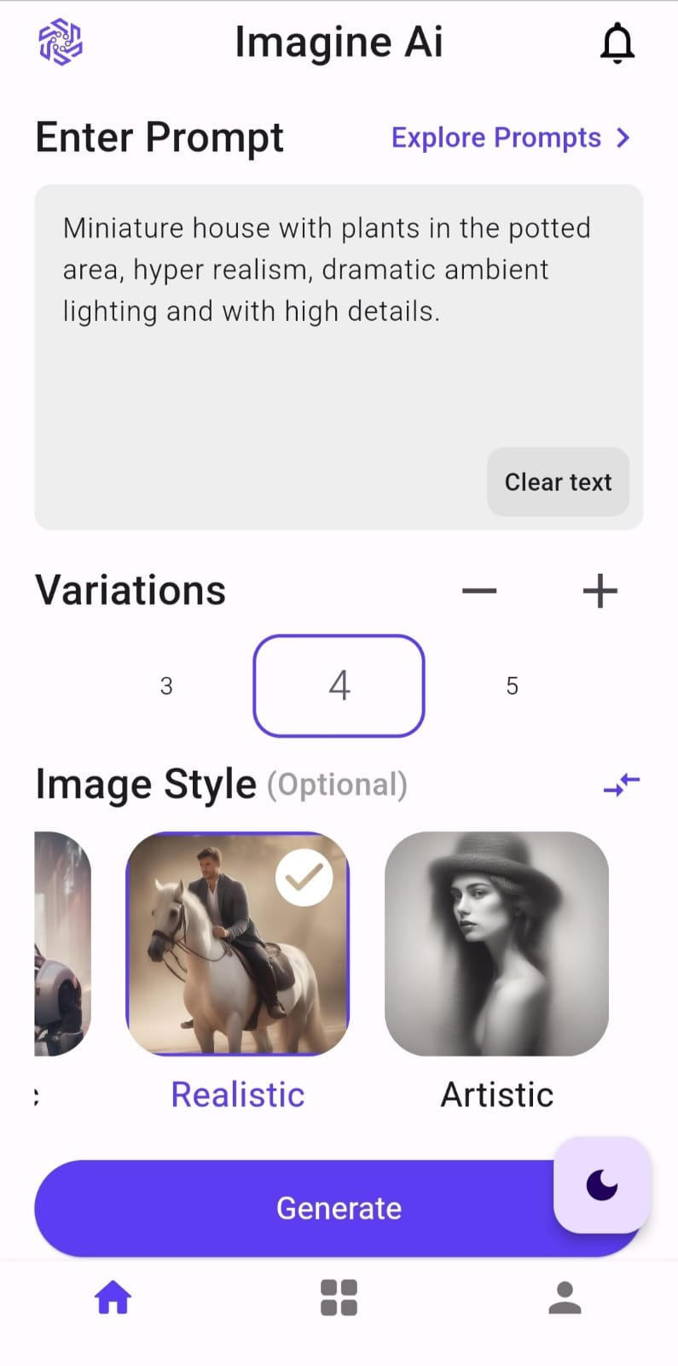
Enter Text Prompt
Select Image variations
Select image filters

Slide 28
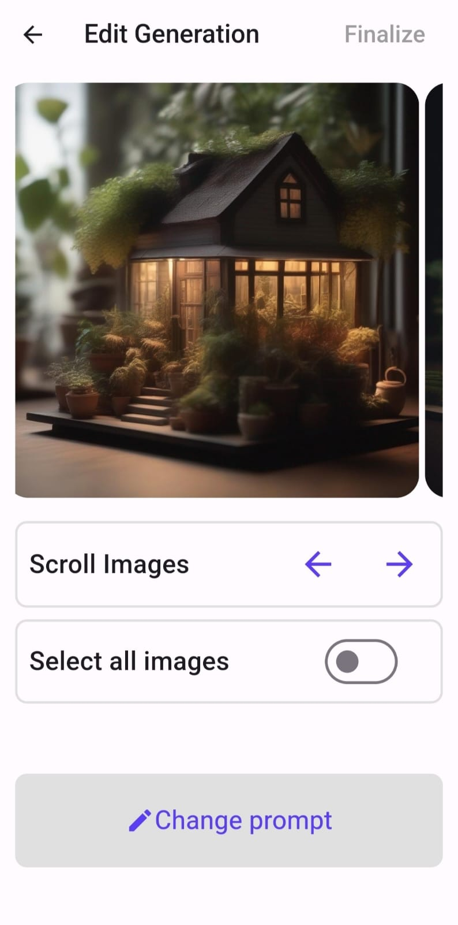
Images generated
Scroll Images
Select images to download
Select images to share on Social Media

Slide 29
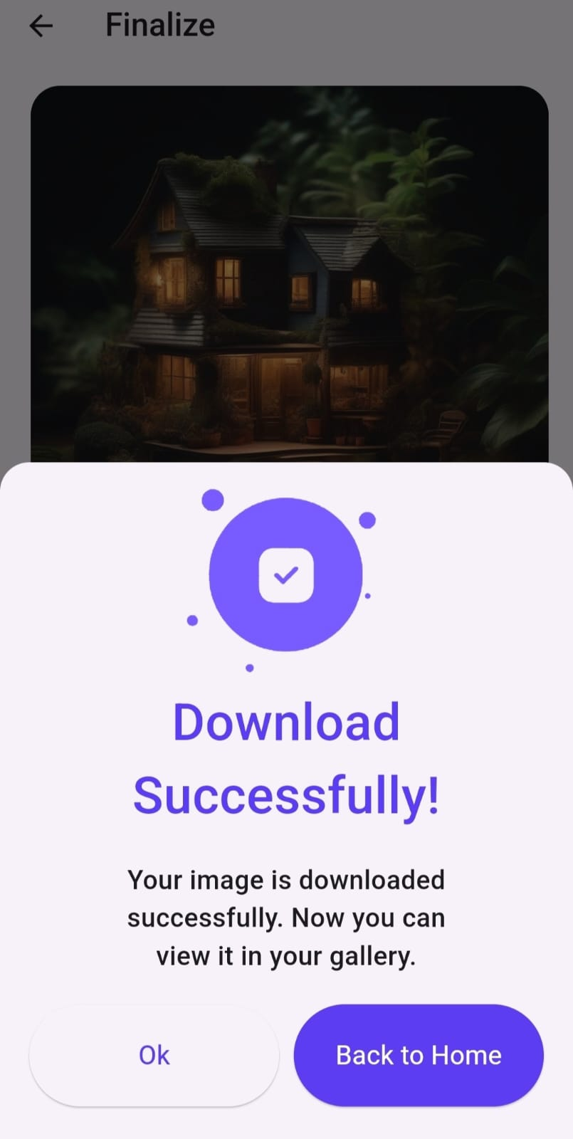
Images downloaded successfully
Image can be shared

Slide 30


